Slide 1
Compiler Design
CSE 420

Slide 2
CSE-420 Compiler Design Course Instructor
Iffat Anjum (IFF)
Formal Email:
iffatanjum@cse.du.ac.bd
iffat.16.cse@gmail.com
Phone: 01814928290
Google Class Code: ppor39

Slide 3
CSE-420 Compiler Design Grading Policy
40% - Final Examination
20% - LAB performance
20% - MID Examination
5% - Assignment & Surprise Quizzes
10% - Declared Quizzes
5% - Attendance
No students will be allowed to sit for final examination if he/she has less than 70% attendance in LAB Class and less than 75% attendance in Theory Class

Slide 4
Surprise Quizzes
There will be surprise quizzes, given at the start of a lecture, during any lecture.
NO LATE or MAKEUP SURPRISE QUIZZES, under any circumstances whatsoever.
Surprise quizzes are completely individual efforts.
Your best strategy is to play it safe – attend every lecture.

Slide 5
Assignments
Assignments need to be hand-written. I will not accept typed up solutions.
Assignments are completely individual efforts.
If two written solutions are the same or similar, both will be penalized (100% penalty for the entire assignment).
If a written solution is similar or same as an online or other solution resource, you will be penalized (100% penalty for the entire assignment).

Slide 6
Playing it safe in CSE-420
If you follow these 4 simple rules during the class, you'll make sure that you do well in the course:
Attend every Theory and LAB classes.
Read the course material (textbook sections assigned + slides).
Submit everything (Assignments, Quizzes, Exams) on time - don't be late.
Don't cheat.

Slide 7
Quizzes and Exams
Two Quizzes
Several Surprise Quizzes
Several Assignments
If you fail to attend any exam you will get 0 (zero) on that exam.
No makeup exams unless with documented medical emergency.
No late submission.

Slide 8
Pre-requisite Knowledge
Strong programming background in C, C++ or Java
Some background on Automata Theory (NFA, DFA, CFG) is recommended…… ……not mandatory
Assembly Language Programming and Machine Architecture

Slide 9
Why Study Compilers?
Become a better programmer(!)
Insight into interaction between languages, compilers, and hardware
Understanding of implementation techniques
What is all that stuff in the debugger anyway?
Better intuition about what your code does

Slide 10
Why Study Compilers?
Compiler techniques are everywhere
Parsing (little languages, interpreters, XML)
Database engines, query languages
AI: domain-specific languages
Text processing
Tex/LaTex -> dvi -> Postscript -> pdf
Hardware: VHDL; model-checking tools
Mathematics (Mathematica, Matlab)

Slide 11
Why Study Compilers?
Fascinating blend of theory and engineering
Direct applications of theory to practice
Parsing, scanning, static analysis
Some very difficult problems (NP-hard or worse)
Resource allocation, “optimization”, etc.
Need to come up with good-enough approximations/heuristics

Slide 12
Why Study Compilers?
Ideas from many parts of CSE
AI: Greedy algorithms, heuristic search
Algorithms: graph algorithms, dynamic programming, approximation algorithms
Theory: Grammars, DFAs and PDAs, pattern matching, fixed-point algorithms
Systems: Allocation & naming, synchronization, locality
Architecture: pipelines, instruction set use, memory hierarchy management
Notes:
Au02: taken from one of Cooper’s slides

Slide 13
You might even write a compiler some day!
You’ll almost certainly write parsers and interpreters in some context if you haven’t already

Slide 14
Some History
1950’s. Existence proof
FORTRAN I (1954) – competitive with hand-optimized code
1960’s
New languages: ALGOL, LISP, COBOL, SIMULA
Formal notations for syntax, esp. BNF
Fundamental implementation techniques
Stack frames, recursive procedures, etc.

Slide 15
Some History
1970’s
Syntax: formal methods for producing compiler front-ends; many theorems
Late 1970’s, 1980’s
New languages (functional; Smalltalk & object-oriented)
New architectures (RISC machines, parallel machines, memory hierarchy issues)
More attention to back-end issues

Slide 16
Some History
1990s and beyond
Compilation techniques appearing in many new places
Just-in-time compilers (JITs)
Software analysis, verification, security
Phased compilation – blurring the lines between “compile time” and “runtime”
Using machine learning techniques to control optimizations(!)
Compiler technology critical to effective use of new hardware (RISC, Itanium, complex memory hierarchies)
The new 800 lb gorilla - multicore

Slide 17
Recommended Books
Aho, Lam, Sethi, Ullman:
Compilers: Principles, Techniques, and Tools
(2nd Edition)

Slide 18
The Course covers
Compiler Basics
Lexical Analysis
Syntax Analysis
Semantic Analysis
Runtime environments
Code Generation
Code Optimization

Slide 19
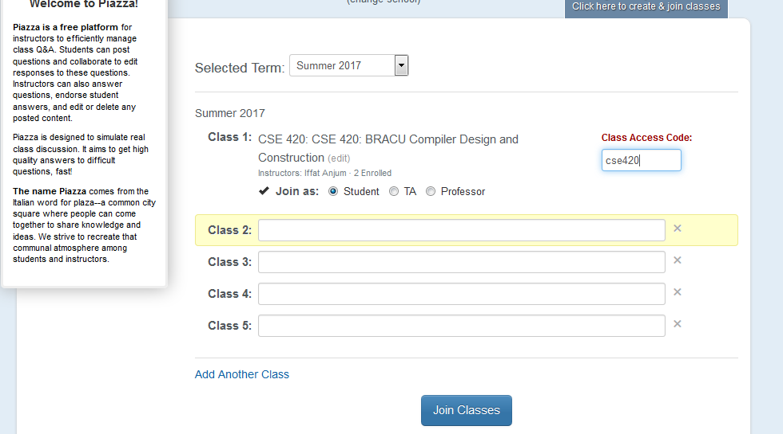

Slide 20
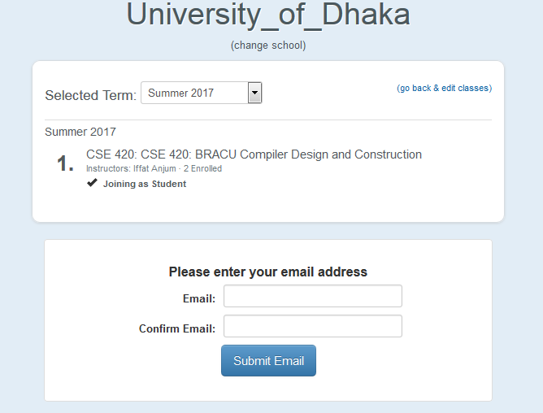

Slide 21
Question?

